Slide 1
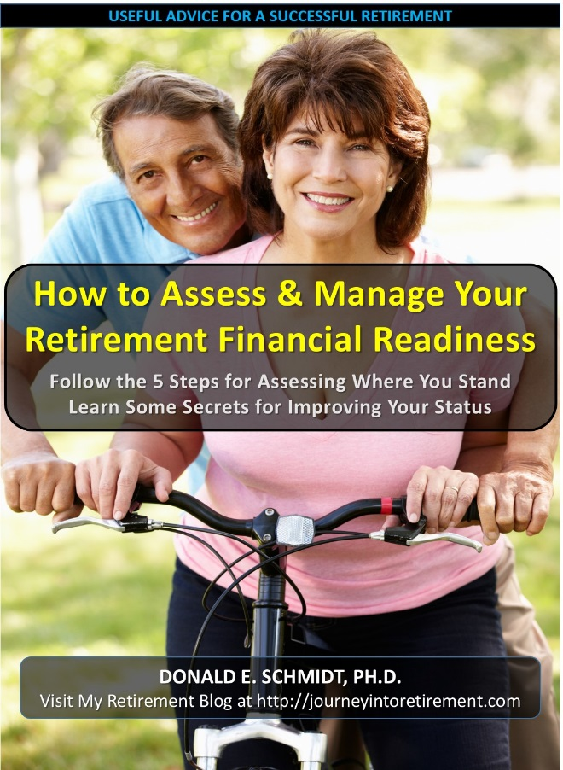
HOW TO ASSESS & MANAGE YOUR RETIREMENT FINANCIAL READINESS
Follow the 5 Steps for Assessing Where You Stand
Learn Some Secrets for Improving Your Status
BY DONALD E. SCHMIDT, PH.D.
Purchase on amazon.com for the low Price of $4.99 Download to your Kindle or App
“DO I HAVE ENOUGH MONEY TO RETIRE?” As the wave of boomers approach retirement, this is the question on the minds of many. But, how do you find an answer to this most important, but complex of questions? Will a refrigerator crate over an urban heating grate be your version of “condo living” in retirement or will you thrive? There is a lot written on this topic, but how do you put the pieces together to get an answer for you?
This book provides a practical, hands-on guide as you
plan for that magic day. As we review the important
factors that affect your finances, you will develop your
own personal profile – things like your sources of
income, your expenses, and decisions about relocation.
This profile will be entered into tools downloaded from
the author’s retirement blog. In the end you will have a
personal answer to the retirement finances question.
However, since retirement planning is not a “do it one
time and forget it” kind of activity, you also will be able to
evaluate “what if” scenarios to assess the financial
implications of various alternative retirement decisions
you might make.
EXAMPLES OF QUESTIONS:
- What will your savings be at retirement and how long
will they last?
- Can you retire early or should you plan to work longer?
- How likely are you to run out of money before you run
out of life and how can you hedge your bets?
- Will post-retirement employment be a choice or a necessity?
- What are the hidden benefits of delaying Social Security that can significantly increase your
income (they are not what you think)?
- How can you lower retirement expenses without lowering your standard-of-living?
- How do inflation and investment returns affect your retirement financial security and how can you
plan for these volatile, but important factors?
This book is designed to enlighten and empower you as you plan for a successful retirement. It brings all of the important factors into focus and answers two key questions: “what does this mean for you” and “what can you do to improve your prospects?”
AUTHOR’S NOTE: The downloadable tools require a PC with Microsoft Excel 97 or above installed. They are powered by VBA macros that may not work properly on other spreadsheet programs.
Join the conversation on my blog: http://journeyintoretirement.com

